Slide 1

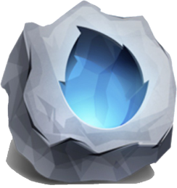
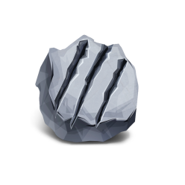

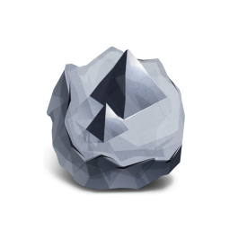
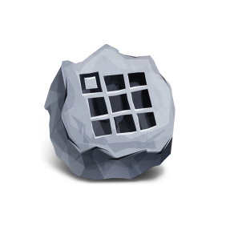

Hello CocoStudio
Mr.Rao

Slide 2
Outline
1
Review of cocos2d-x.
2
Why CocoStudio?
3
How to prepare your game?
4
Design in UI Editor.
5
Experiment for UI Editor.

Slide 3
Review of cocos2d-x

Slide 4
Basic Concepts
CCScene
CCLayer
CCSprite
Contain layers
Contain sprites
Main objects
Separate game
Listen events
Useful actions
Transition effect
Specialized

Slide 5
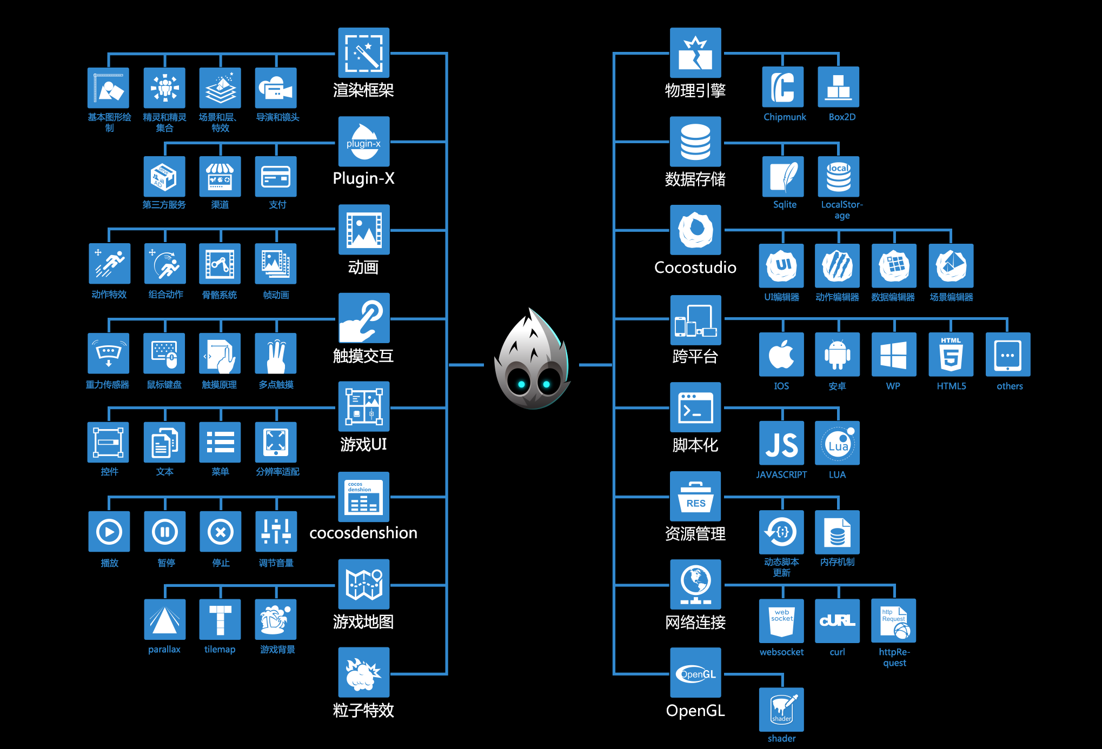
Try to learn these
when you need.

Slide 6
Beyond coding,
What is essential
in a game?

Slide 7





Game Design
Game Development
Game Art
Game Coding

Slide 8

CocoStudio
Unlash your Creativity,
Speed up your Development

Slide 9

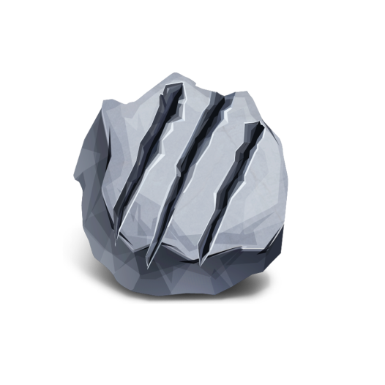
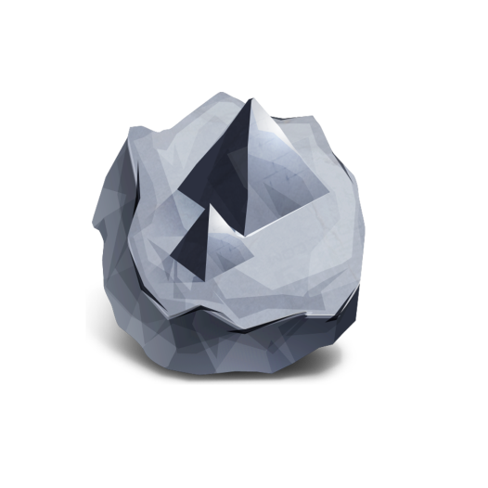
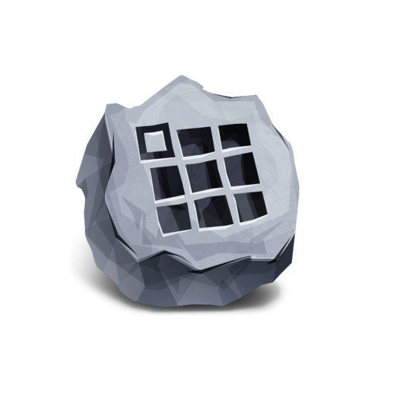
CocoStudio
Game Development Tool Suite
UI
EDITOR
ANIMATION
EDITOR
SCENE
EDITOR
DATA
EDITOR
2D UI Editor.
All kinds of widgets.
Synchro with
cocos2d-x.
Bone Armature.
Frame Animation.
Flash Support.
Container Editor.
Visualization Scene.
Excel Import.
Data Management
tool.

Slide 10
Resources Support

Slide 11
How to get resources?
Create Yourself
Graphic Artist
Internet
Huge Harvest
Professional Art
Free & Easy
Great Difficulty
Hard To Find
Copyright Issue

Slide 12



NOTE
You may add these to your bookmarks
P
opengameart.org
www.designkindle.com
ictures
pixtea.com
freepsdfiles.net
www.psdchest.com
花瓣网、站酷、昵图网
A
www.bfxr.net
udios
sc.chinaz.com/yinxiao/

Slide 13
Three steps to get fast to deal with your images.
1. Cut out a regular shape.
2. Wipe out unwanted pixel.
3. Export a .png format.

Slide 14
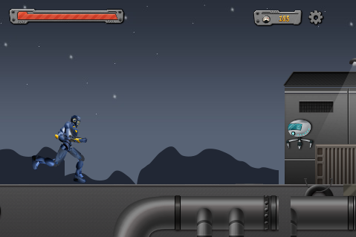
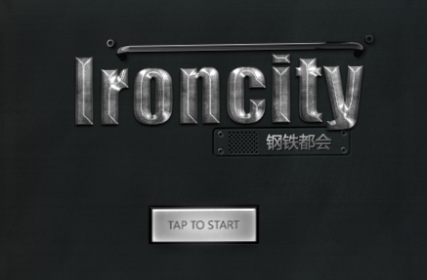
IronCity Demo : https://github.com/yuye-liu/CocoStudioIronCity
※ A platform shooting game.
※ Made by CocoStudio v1.0.2.
※ Cocos2dx and Cocos2d-html5

Slide 15
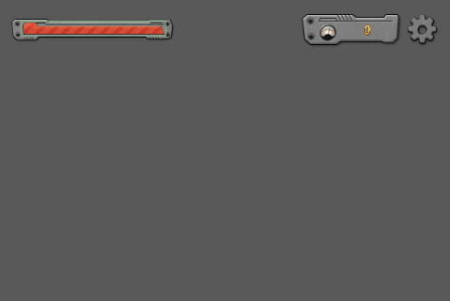
How to build IronCity Game Menu UI: UI Editor
Firstly
Decide which kind of widgets should be included.
I want a blood bar, distance score and setting button.

Slide 16
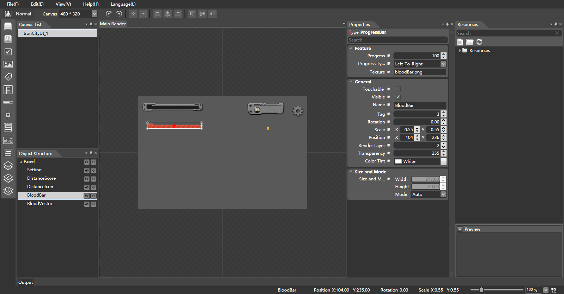
Secondly, put everything you need by adding widgets.
Tools
widgets
Add Resources
Adjust position of widgets to create the Menu UI like the previous page.
Notes:
This is UI editor. You should build a new project before you use it. The yellow parts are comments. CocoStudio contains 4 editors, it is good because it makes each of the editors concise and easy to learn.
The tools provide 8 ways to help you align and 2 ways to rotate. You can set up the resolution of your UI Layer by canvas, it offers several kinds of resolution just beside the tools (which offers several different resolutions just by the tools). You can see a normal button on the left side of canvas, this button(use which or start a new sentence) changes UI editor from normal mode to animation mode. The animation part is almost the same as the animation Editor, so I will talk about this in animation editor.
There are 14 widgets in the widgets toolbar. You can learn how to use them in the sample case “CocoStudio test” from the cocos2d-html5. I will introduce some of them later. All of the widgets can be dragged into the main render. If you held down blank button on keyboard, you can move your canvas on the main render by your mouse. Some of shortcut keys in CocoStudio is similar to that in PhotoShop. Then you pull the picture resource from the Resources Menu into the Properties. In this case, I dragged a “bloodBar.png” to the my bloodBar’s texture. The resources menu supports importing or dragging a .psd file, but the names of the resources should be English, or it may cause some problems. Same with the path of the projects.
Here I have added all widgets I need and set up the pictures from resources. The object structure shows the hierarchy of the layer, but that is not the real order in the game. In cocos2d-x and cocos2d-html5, we use Zorder to represent the hierarchy of the sprites, while in UI editor, it is called “render layer,” and can be found in Properties Menu of every widgets.

Slide 17
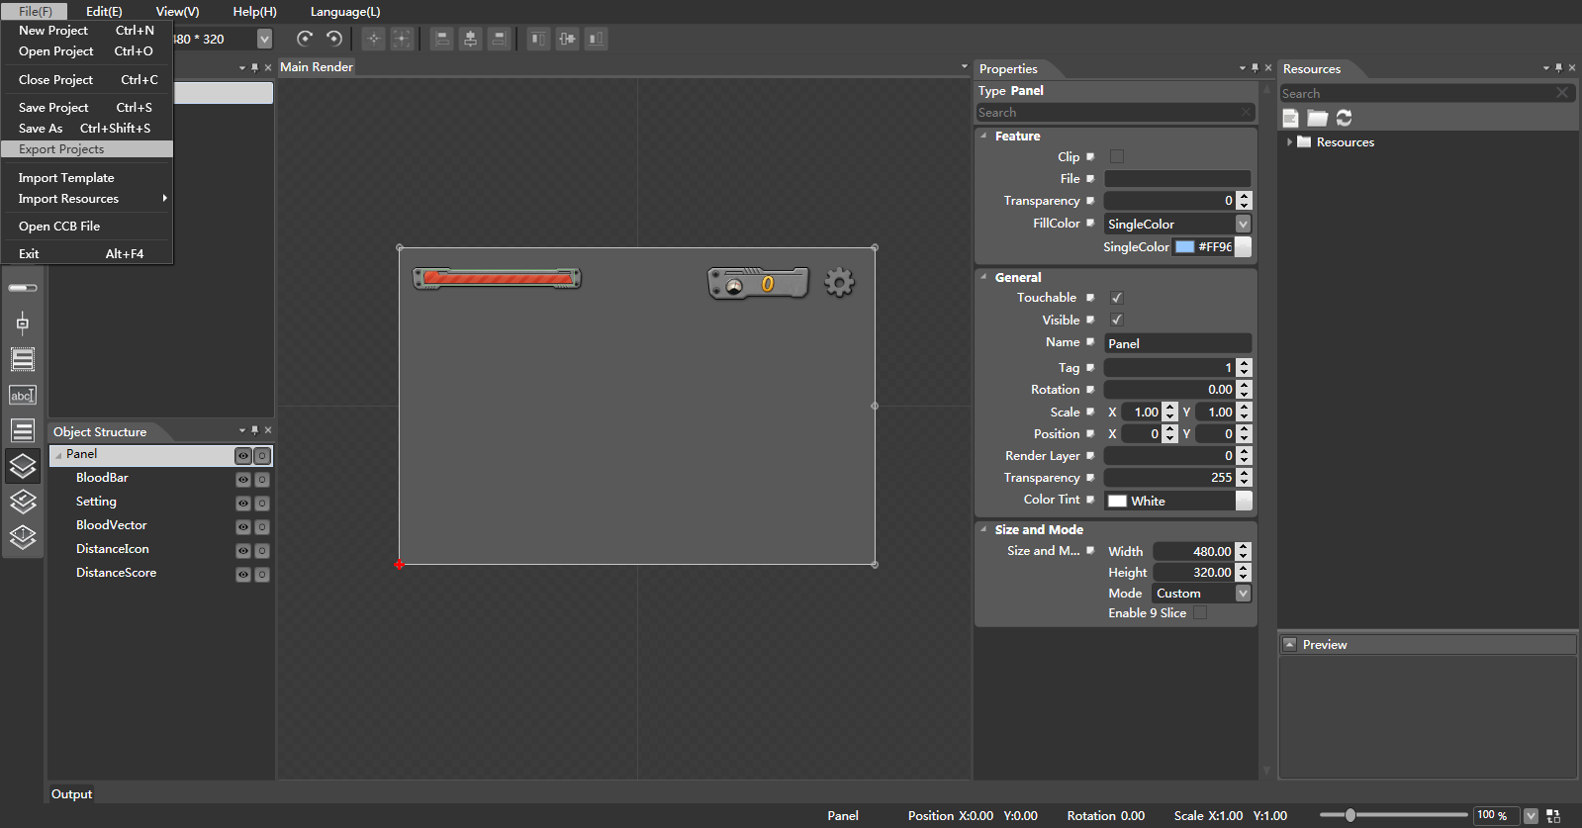
Final Step: Export
Tick this in the parent node.
Notes:
The final step is easy. I have prepared everything for my Game Menu UI layer. Just click “export projects” in the file. Most of the time, we use the default setting for exporting. Don’t forget to set the properties of the parent node before exporting. For example, if you didn’t tick the “touchable,” everything belongs to this parent cannot be touched, even if the child node has ticked the “touchable” on it’s own property.

Slide 18
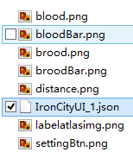
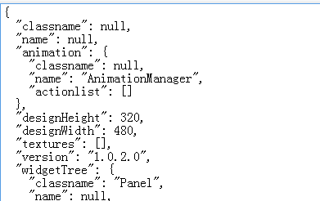
NOTE
Try to read the json file
Put all of the export files into your game resources.
It’s easy to read a .json file.
Notes:
After exporting, you will see a number of files in the export folder of your CocoStudio project. Put all of them into your game resources. There would also be a .json file. This is a JavaScript Object Notation file, a kind of data exchange language. All of your settings in the UI editor have been saved in this file. Sometimes you may figure out your problems through this file, it’s easy to a .json file.

Slide 19
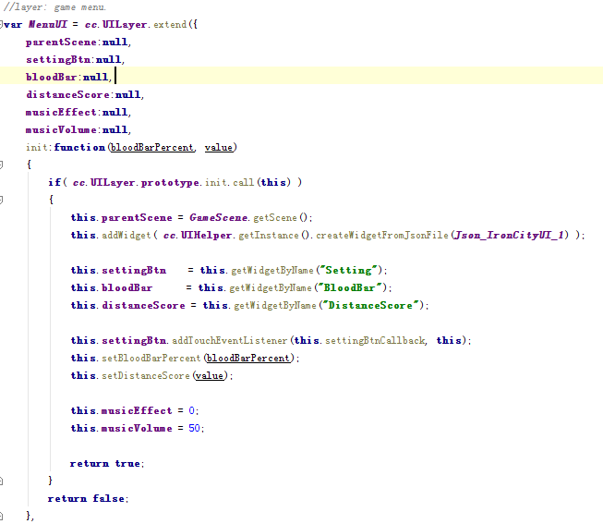

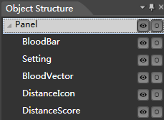
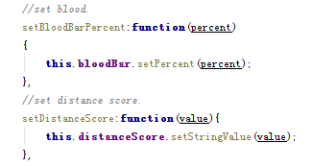
How to use the exported resources?
Notes:
Let’s see how to use the exported resources in IronCity. Here is the Layer Menu UI and it’s (an?) initial function. To read the .json file in this layer, use “this.addWidget( cc.UIHelper.getInstance().createWidgetFromJsonFile(Json_IronCityUI_1) );” In IronCity, we arranged all of the resources constant to another file. We have a setting button , blood bar(progress bar), distance score(atlas label), and they all need interaction during the game. So we get these widgets by the getWidgetByName() function as in the pictures. Remember that the name of the widgets can be found in your object structure, or the properties of their own in UI editor project.
Different widgets will have their own interfaces to be called in the program. For example, you use setPercent() to set the rate of a progress bar, and setStringValue() for the atlas label to change the value. All widgets can add a addTouchEventListener() to listen the touch event. Try to learn more in the “CocoStudio test”(section?) in cocos2d-html5.

Slide 20
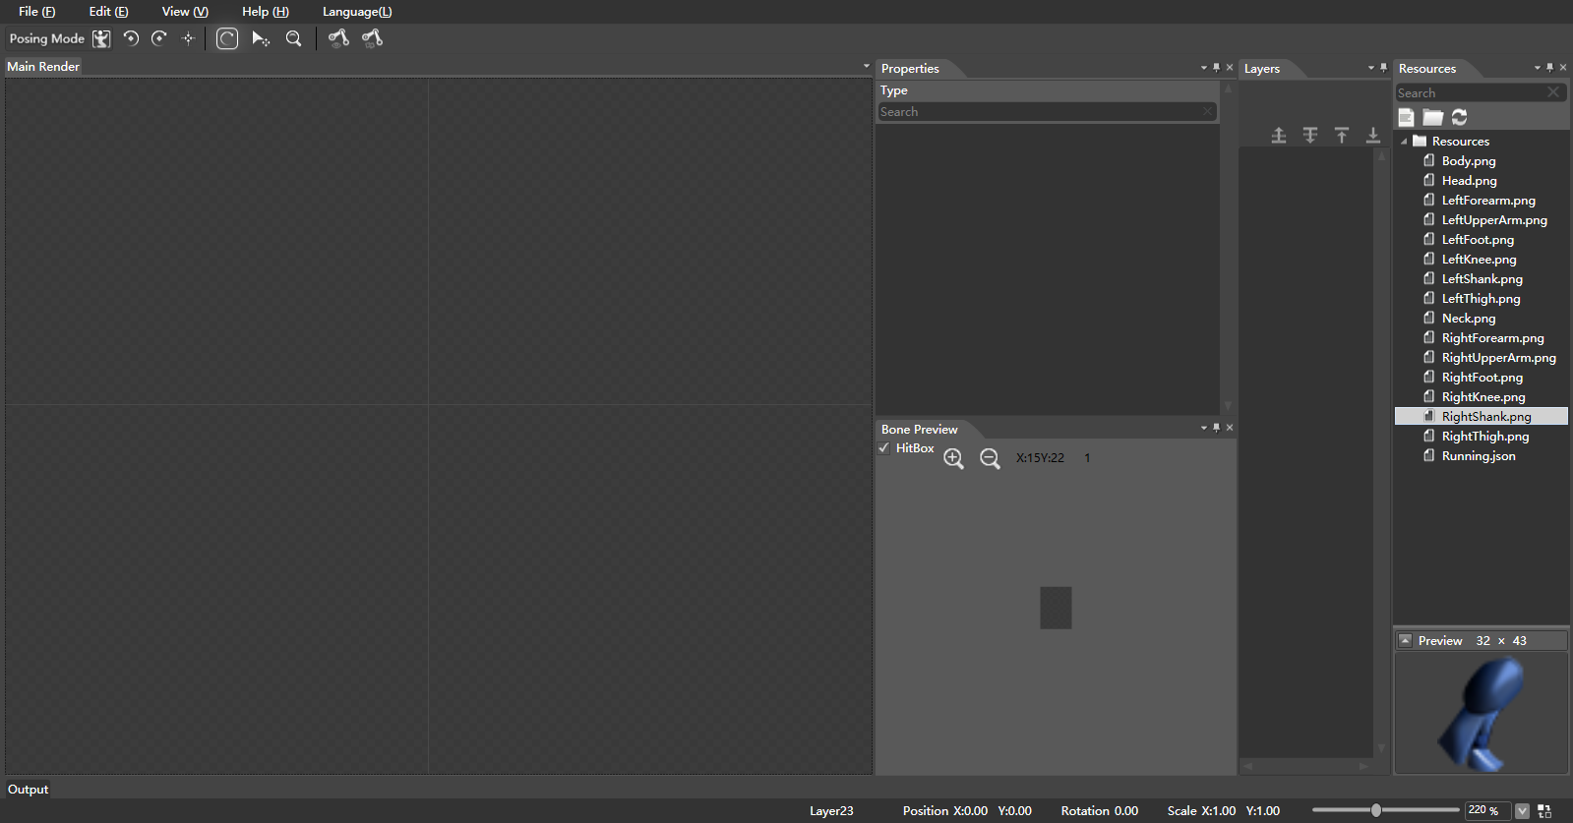
How to build a running animation: animation Editor
Firstly, build a ne project and import your resources.
Change mode
Bone
order
Center point
Draw collision region
Notes:
We are going to create a running animation for the cocoMan(CocoMan?) in IronCity, and this is what animation editor does.
So I built a new project named “running,” then I dragged all of my resources into Resources Menu.
The picture is the screenshot. The default mode is in the Posing Mode, you can change it into Animation Mode with the button in the upper left corner. Same story with the UI editor.
Next, let’s find out how to create a complete armature in animation editor.

Slide 21
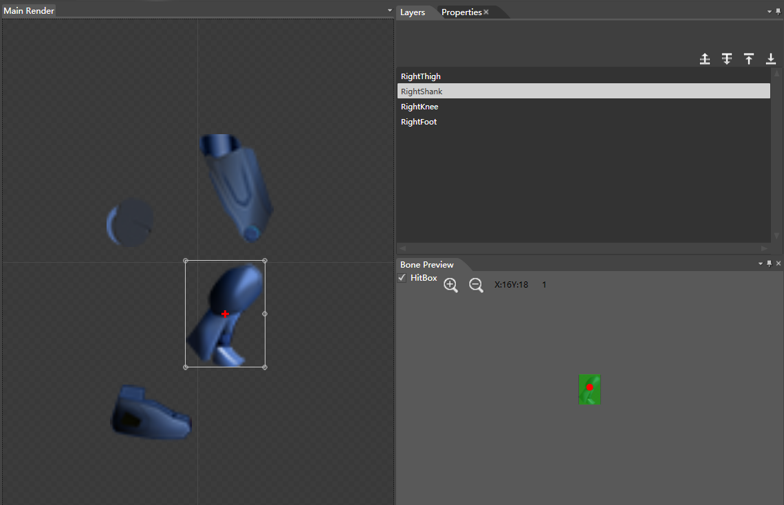
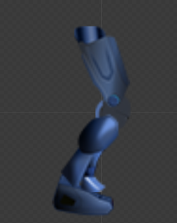
Dragged your resources into main render.
After combination
Double click can rename the names.
Tick the HitBox and draw the collision region here.
Notes:
To create a whole armature, every picture of the bones should be complete.
A good design of an armature is important. In IronCity, we divided the cocoMan into 6 parts. We created the parts of the body(body parts?) by using 2-4 bones and assembled them when they are finished.
So, in this case of picture(in this case as the picture shows?), we put all of the pictures into the main render. This is a right leg, consisting of 4 skeletons: thigh, shank, knee and foot. Then you can draw the collision region part in the HitBox. Here I just show you can create it, but we didn’t use the way of CocoStudio animation editor to detect collision. We used another way to do this thing. Because the more bones and its collision regions you create, the lower performance it will be on the browser. That’s why we didn’t use it, so that we don’t have to detect each bone of the cocoMan. If for some reason you still need it, try to find the sample called “TestColliderDetector” in cocos2d-html5. After combination, we have a whole right leg on the main render. It’s time to create bones now.

Slide 22
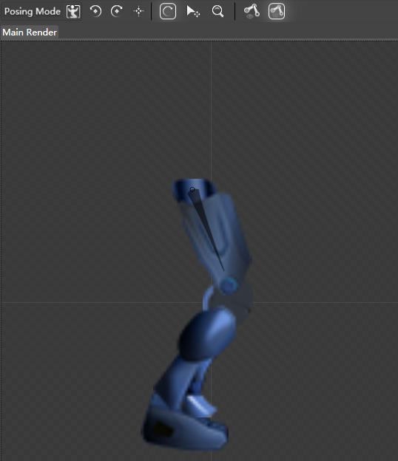
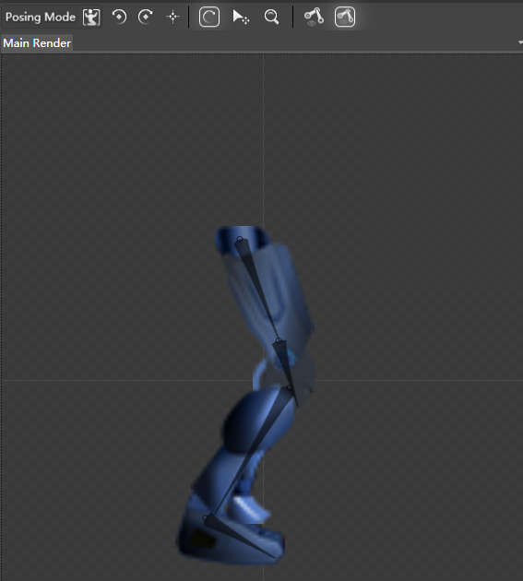
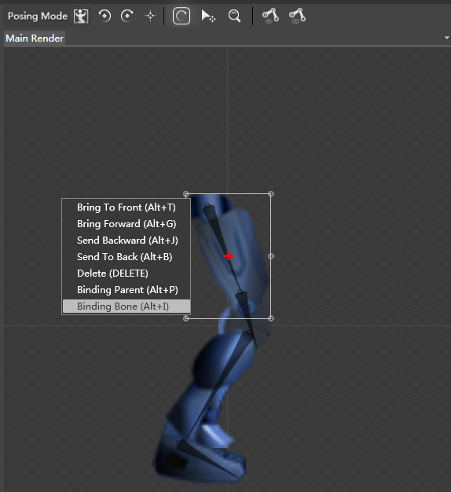
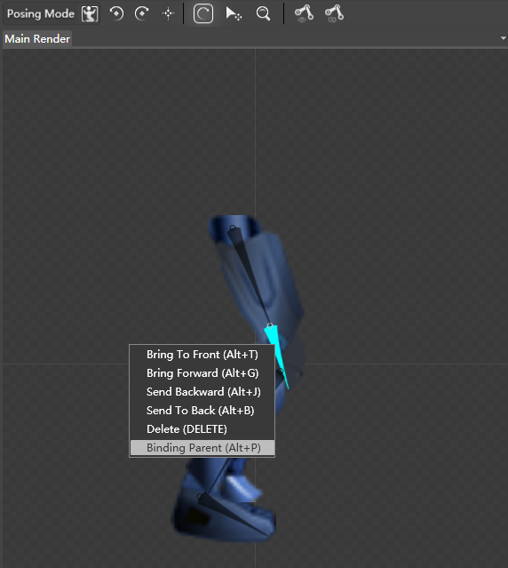
Create right leg part of CocoMan.
Create bone mode
Each picture is a bone
Cancel this mode
Bone
Choose create bone mode.
Bind knee bone to it’s parent.
Draw bones.
Disable create bone mode.
Bind pictures to bones.
Flow Path
Bind children bone to their parents.
Notes:
How to create right leg part of CocoMan.
1. Choose “create bone” mode.
2. Draw bones.
3. Disable “create bone” mode.
4. Bind pictures to bones.
5. Bind children bone to their parents.

Slide 23
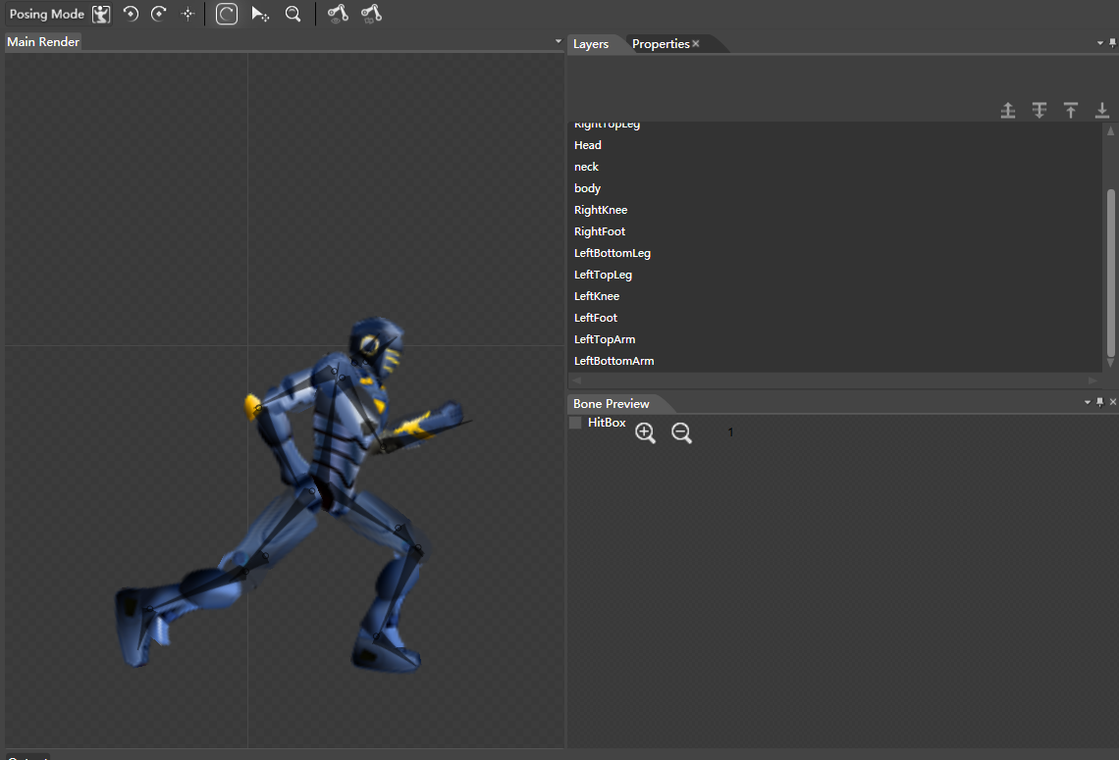
After long working…
Notes:
After all the work, I have created all parts of the cocoMan and finally assembled them into our cocoMan just like playing Jigsaw. Don’t forget to bind parent bones when it comes to the joint. This pose is going for the start of running animation. All of the other poses will be extended or copied from this basic armature. Next we are going to create animations.

Slide 24
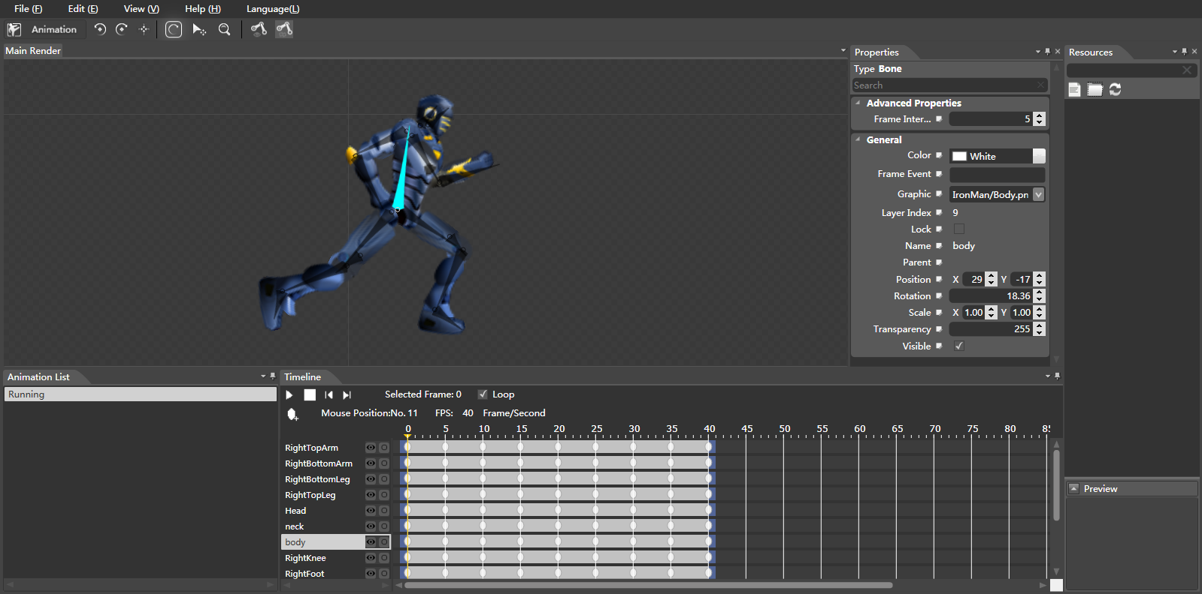
Animation Mode
Rotate
Shift
Add or copy new animations here
Notes:
Change the mode into animation (Press the button on the left upper corner.)
The interface of animation mode in UI editor and animation editor are almost the same, as well as their usages.
The timeline is the core of creating an animation. If you know anything about flash or spine, it should be easy to get started.
There are many frames in the timeline. Each frame represents a time point for the armature. Using rotate or shift button to set up the status and poses for each bone of the armature on the key frames, and you will get an animation.

Slide 25
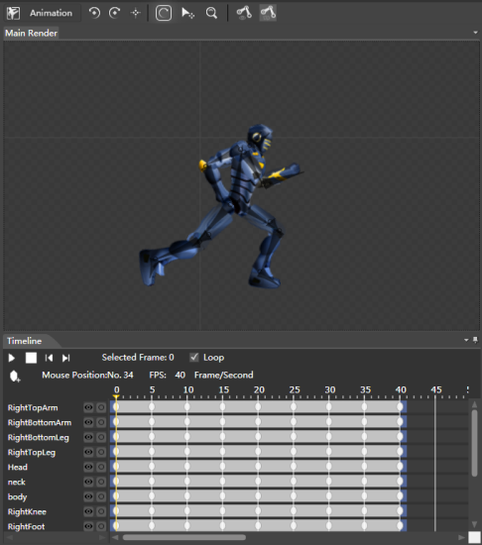
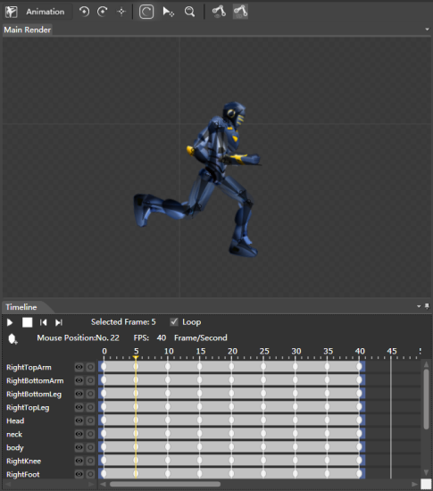
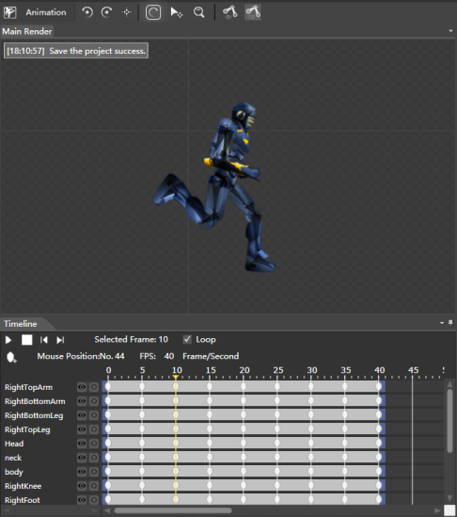
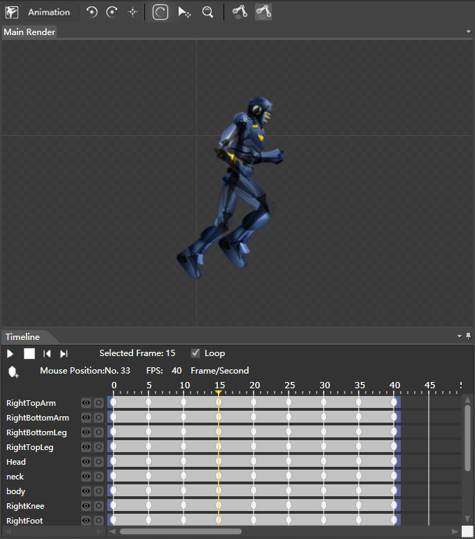
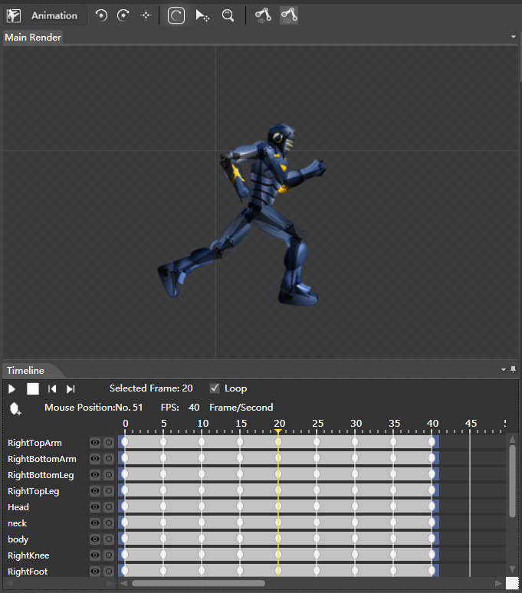
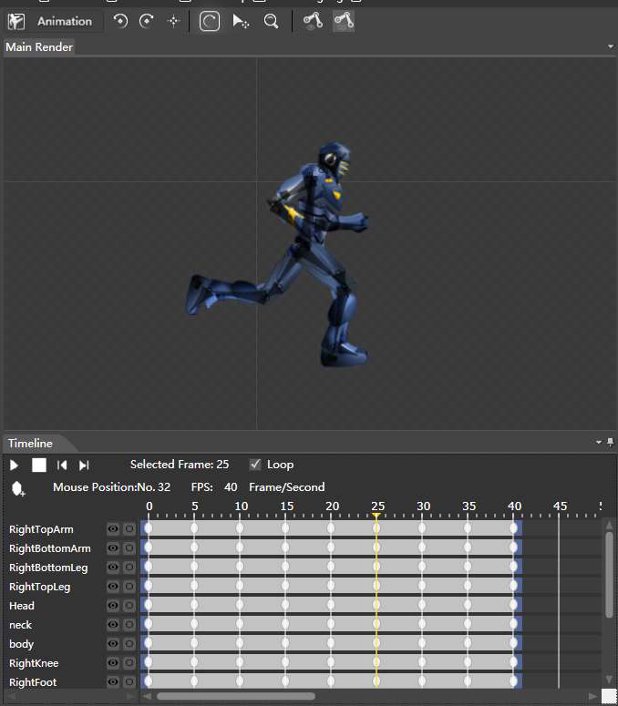
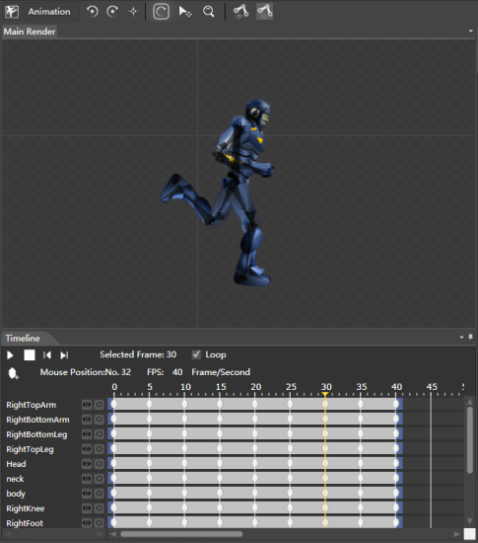
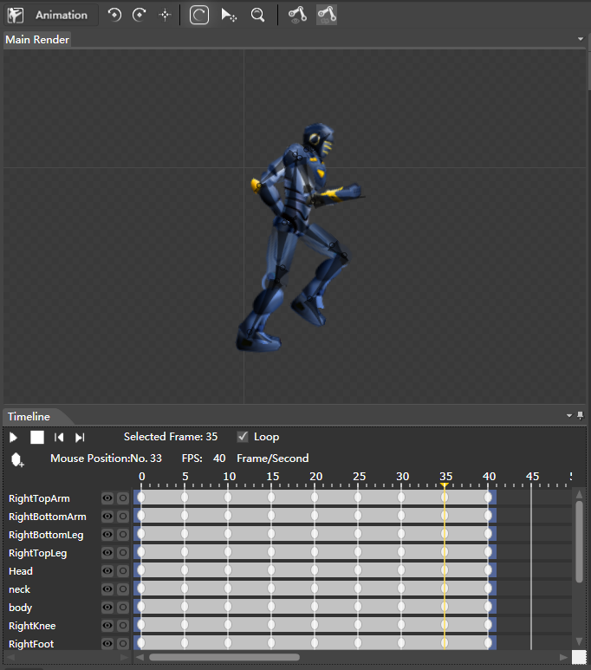
0 Frame
5 Frame
10 Frame
15 Frame
20 Frame
25 Frame
30 Frame
35 Frame
Notes:
These are the key frames of running animation. The Frame 40 is missing because that is identical with Frame 0. In this way, you can make your animation coherence when it comes to a loop(tick the Loop). Press play button in the timeline can show the animation(Pressing, 或者Press play button and you. You can also modify the fps to control the speed of your animation.

Slide 26

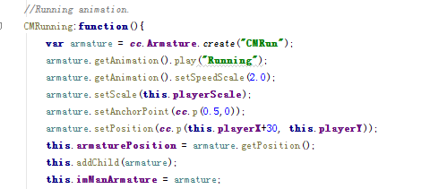
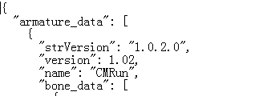
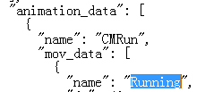
How to use the armature in the program.
Export project and add them into your resources.
Read .ExportJson file.
Create armature and run animation
Notes:
We have finished the armature and animation . You’ll find 3 files in the export folder(default way). The ExportJson file is like the json file， which is rather informative. The function “CMRunning” is a basic way to create an armature and run its animations. cc.ArmatureDataManager.getInstance().addArmatureFileInfo(Json_CMRun) to read the resources from the path. cc.Armature.create(“CMRun”) will try to create an armature called “CMRun” from all the ExportJson file. “CMRun” is the name of your project, but you can also try to replace all the “CMRun”in the ExportJson file; this is a fast way to change the armature’s name. armature.getAnimation().play(“Running”) will begin to find(look for) the animation named “Running” in this armature’s ExportJson file. This name can be set in the animation list from animation editor. You can edit it in ExportJon file as well.

Slide 27
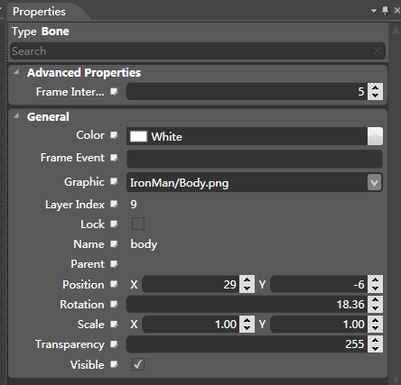
NOTE
How to call back functions?
setMovementEventCallFunc : call back when the animation finish.
setFrameEventCallFunc : call back when the frame finish.
Frame event can be set in animation editor for each bone of every frame.

Slide 28
留给学生的作业(ParkourSample)：
1. 完成障碍物的生成，和碰撞、死亡判定（IronMan的GameScene.cpp的update方法）
2. 使用cocostudio制作陈小哥跳跃的动画，加载到游戏中，单击屏幕来控制这个动画。（ IronMan的GameScenePlayLayer.cpp的CCTouchEnded方法）
3. 使用cocostudio制作3个菜单，1个游戏菜单，1个是设置菜单，一个是gameOver的菜单。(IronMan的GameSceneMenuLayer.cpp GameSceneOverLayer.cpp GameSceneSetLayer)
4. 追加金币和银币，作为计分道具。
5. 扩展游戏地图，从冬天扩展到春夏秋，每次切换背景的时候同时切换粒子效果粒子效果(ParkourSample的GameScenePlayLayer的 backgroundInit(), update())

